Slide 1
DataDive Insight Presentations
December 4, 2016

Slide 2
Curbing Mobility in Foster Care
Visualized over 14,000 child movements
Verified institutional knowledge about racial and age disparities in child outcomes
Notes:
Our findings will help child service agencies know more about what triggers disruptions and be able to identify and stop potentially risky placements
<Ravi, Sharang to kick off>
Remember - you only have about 5 minutes so don’t try to summarize all your work, but pick 1-2 key findings that were most interesting or significant for the Project Champion.
Other Project Headlines:
Keeping it Cool: Using Mobile Technology to Preserve Vaccines
Mapping Poverty to Beat It
Predicting and Preventing Human Rights Abuses

Slide 3
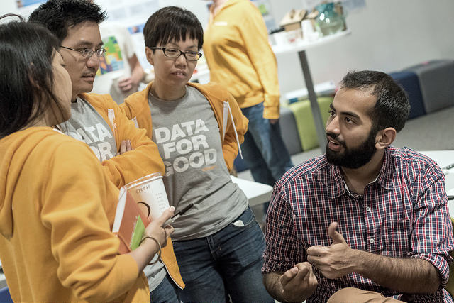
CHALLENGE

Slide 4
Challenge
Understanding Mobility in Foster Care
Are there any trends in a child’s race/age/gender and the number of moves they make during their spell?
Can we identify different groups of children by their move distribution?
How does mobility and other factors influence the probability of a child successful exit?
Notes:
Project Champion - explain why you were excited to participate in today’s event!
What was your data challenge or data opportunity?
What were you hoping to walk away with?
Descriptive understanding of mobility and trends that affect mobility (yes!!)
Race, age at entry, type of placement
Clustering algorithm to identify different groups of children as defined by their mobility (?)
Survival analysis (no)
Data was much messier and more complicated than originally appreciated, ended up spending half the time cleaning.

Slide 5
Approach
Broke up into teams to handle different tasks
Cleaning, cleaning, cleaning
Descriptive Analysis & Visualization
Random Forest
Clustering
Notes:
<Sharang/Ravi/Volunteers?>
Give a brief overview of the techniques your team used. Note: It’s ok to geek out here but don’t get too in the weeds. Define any technical terms for the audience!
Cleaning 80% of the time = T
Descriptive
Random Forest on “Move Reason” Desirability on Spells
Age most influential feature, diggin deeper
Clustering
How did you approach the data challenge?
Broke into teams that addressed descriptive statistics outlined in the project brief, in support of some of the analytics
Was there anything tricky about the data itself?
Where to start..
Many to many: children to multiple spells to multiple placements
Confusingly name fields
Feel free to shout out individual volunteers’ contributions!
Victor for visualizations
An, William and Margaret for Developing Random Forest Model
Peter, Anish, Cydny for descriptives on Providers, children --
Katie and Chloe for descriptives on children and movements
Katrina and Michael for sharing your insights and keeping our spirits up when things got tough

Slide 6
FINDINGS
Notes:
Most of your time should be spent on THIS section - presenting your key findings and the impact it had on the organization.

Slide 7
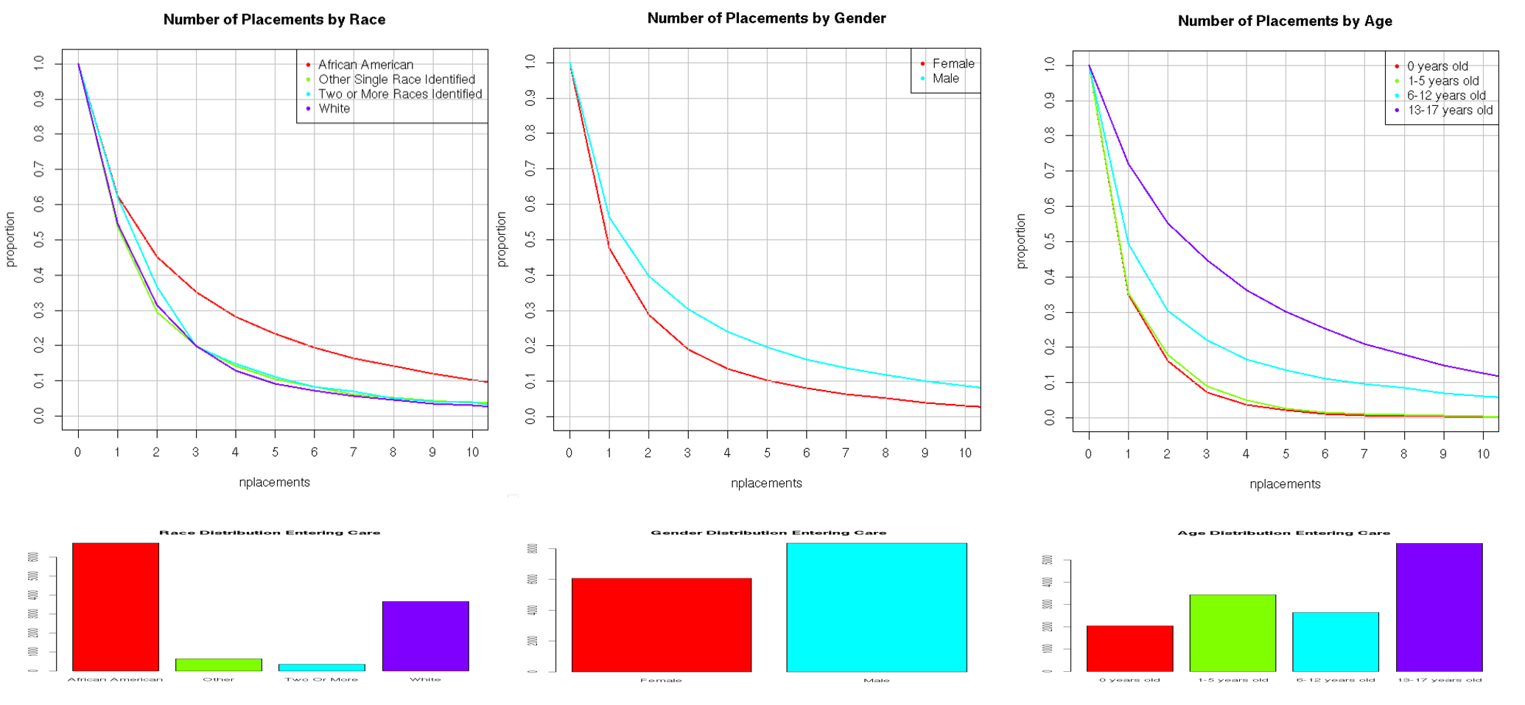
Trends in Moves by Client

Slide 8
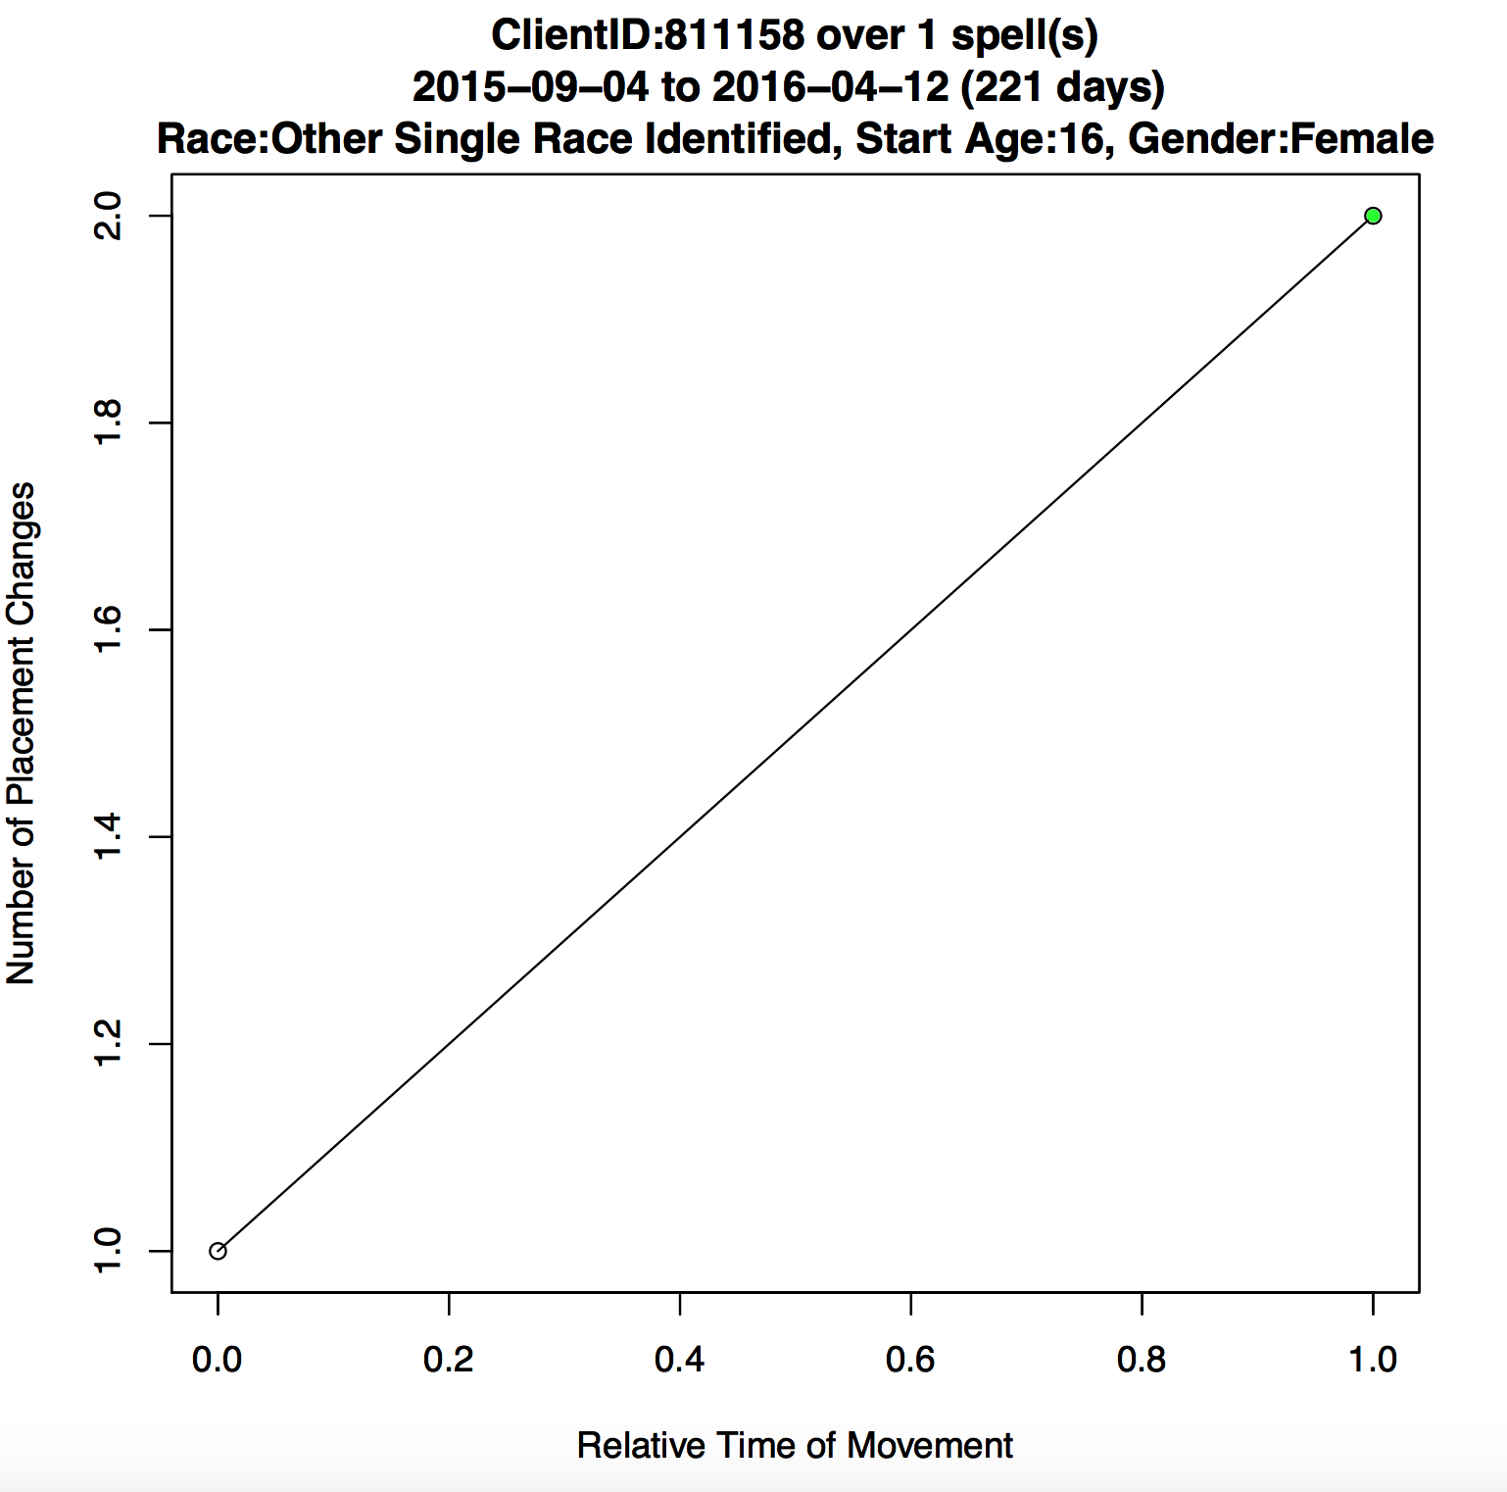
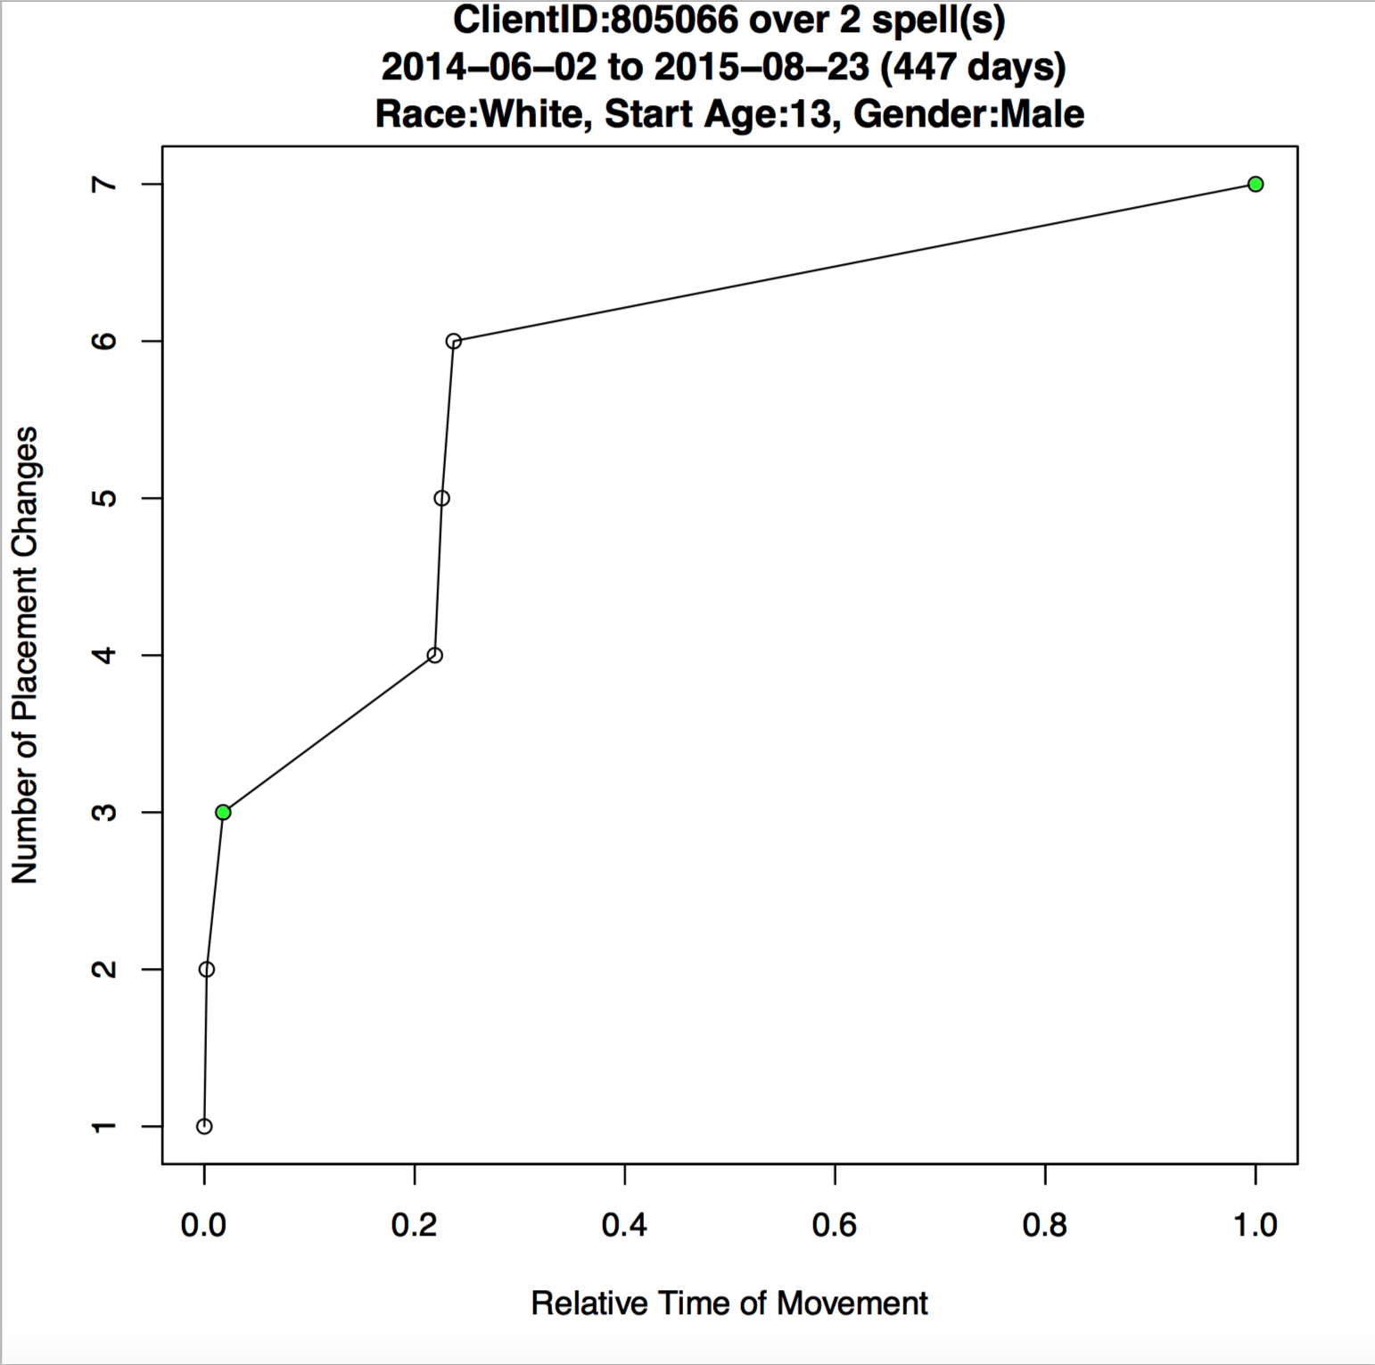
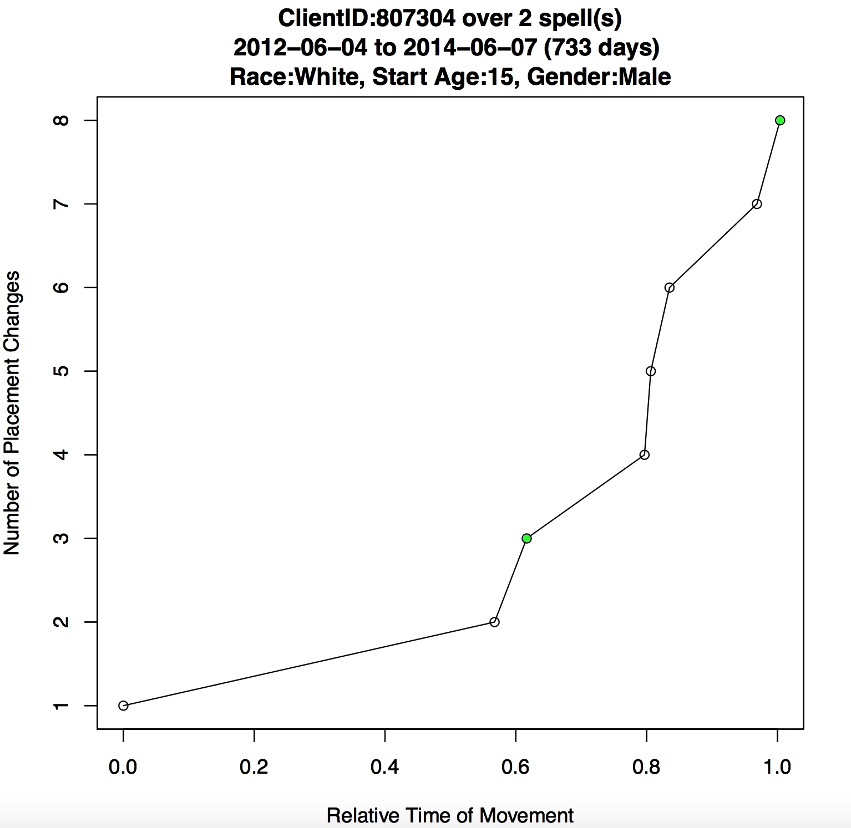
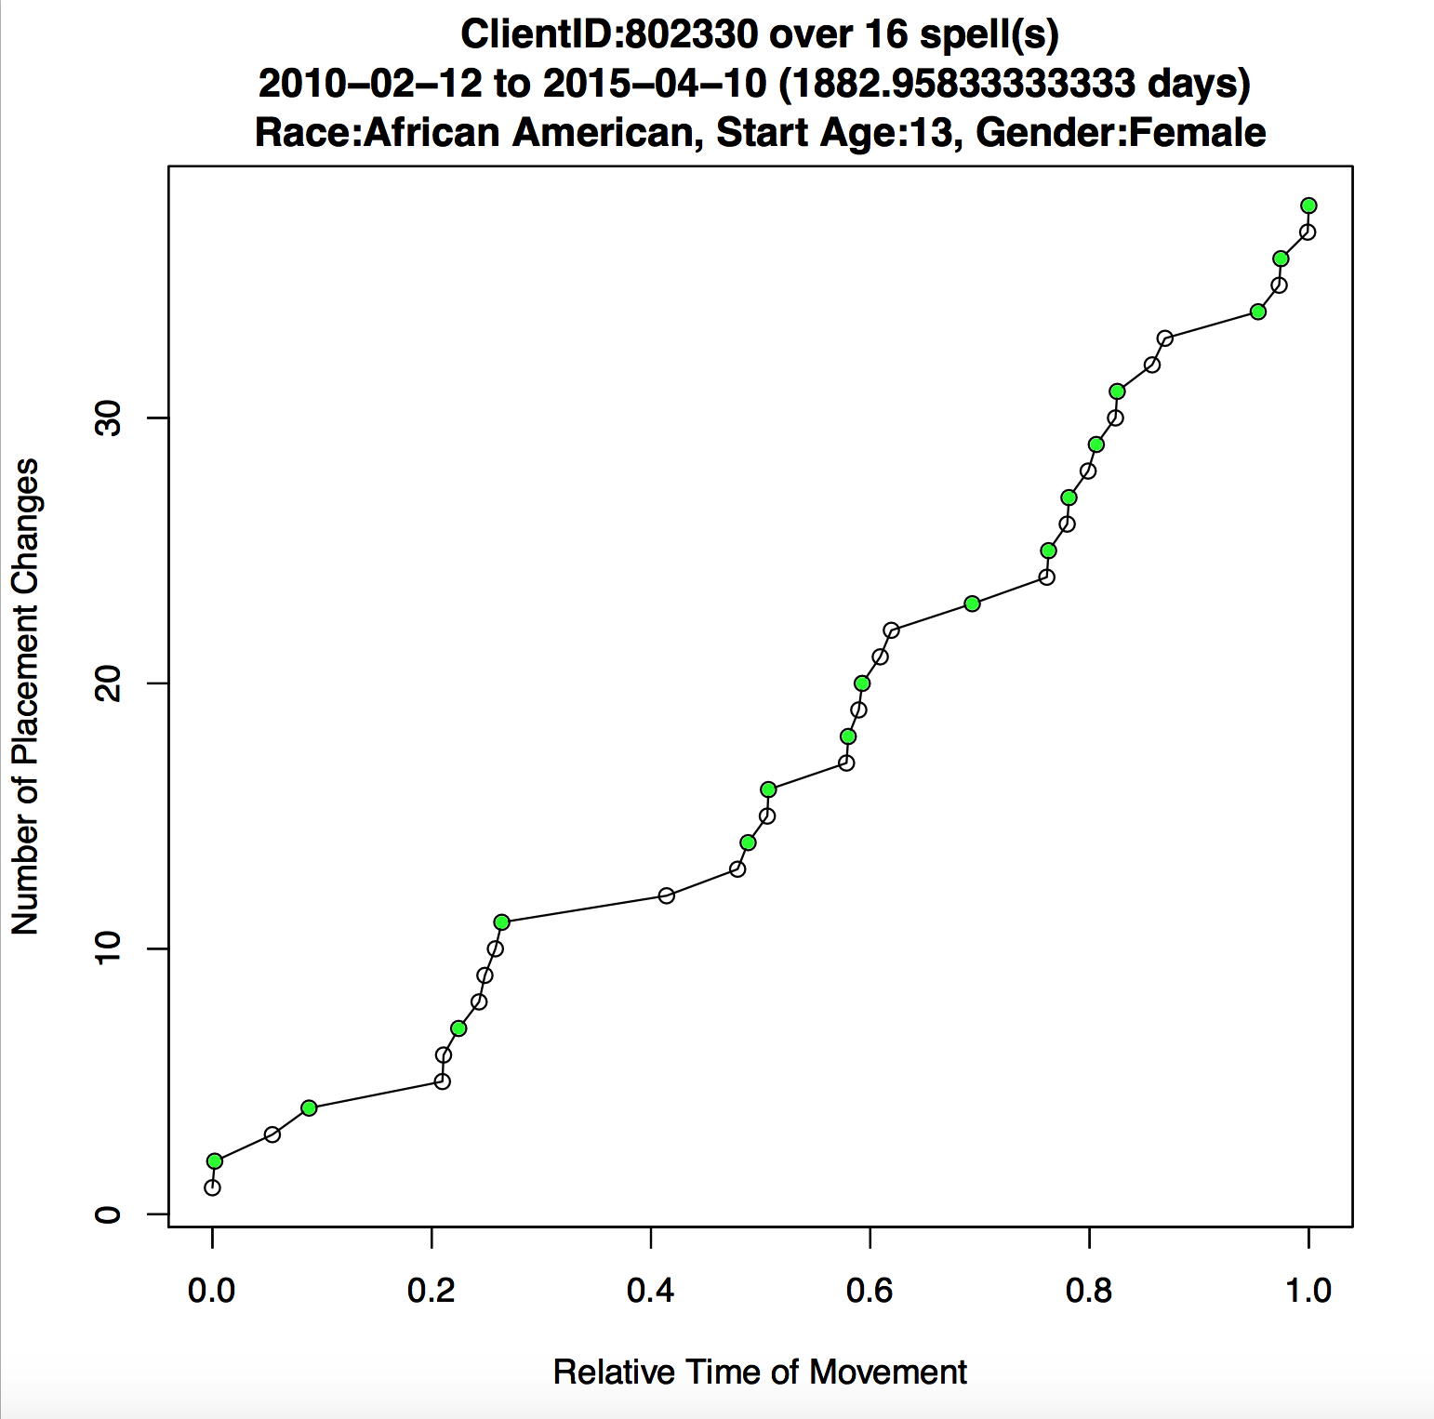
Four Types of
Children in
the System
●those who are stable (no or only a few moves while in care)
●those who move frequently at the beginning of a spell but achieve stability later
●those that have early stability but experience later instability
●those that never have stability
Can we identify these groups within the data?

Slide 9
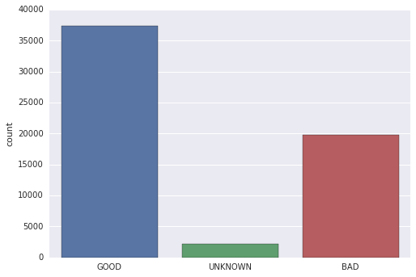
Outcome Desirability
Good: reunified with family legal custodianship adopted
Bad: age out runaway juvenile probation other
Unknown: spell ongoing unknown

Slide 10
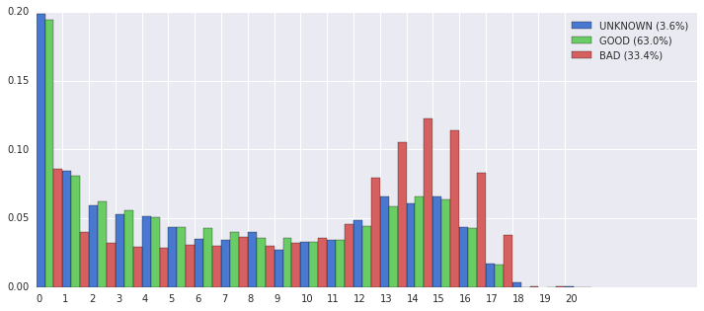
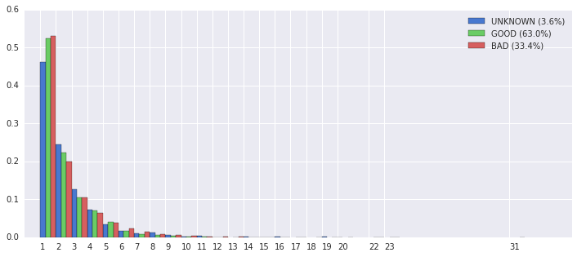
Outcome Desirability
Outcome type by Start Age Outcome type by Primary Placement

Slide 11
Results of the Random Forest
Found several important features
Analytical Technique: Random Forest
How robust? Cross Validation
Important features
Age Children Enter Child Services
Reason they were removed from their home
If they go to a group home
Duration in a spell
Number of Placements
Surprisingly the month that they entered
Interactions between features are important!
We focused on spell data, but placement data should be examined

Slide 12
NEXT STEPS

Slide 13
Next Steps
New data → More Questions
Further analysis of new data sets
New methods to visualize children’s data for use by caseworkers
Qualitative analysis to find the why behind the data
May incorporate visualizations into Tableau or dashboards
Notes:
<Katrina to Speak>

